Slide 1
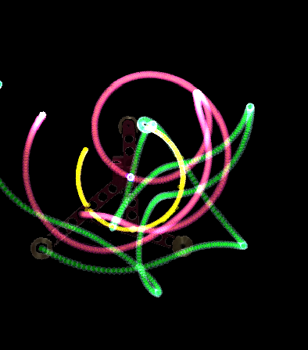
Angle and mass determinants on the chaotic motion of a triple pendulum
PHYS1902 Project Group 2 Friday 2pm
520487532 Murray Jones
200491720 Yunki Yau
520510069 Riley Fitzgerald
52042275 Adrian Wong
510511793 Riley Jones

Slide 2
Introduction
The pendulum system is a classical mechanical system used to study chaotic motion.
Chaos is defined as sensitive dependence on initial conditions.
The triple pendulum in particular, is highly complex:

Slide 3
Aims
Aim: To quantitatively measure the chaotic motion exhibited by a triple pendulum and relate this to various initial conditions:
The starting angle of the pendulum (0, 15, 30, 45, 60, 90, 135, 150, 180 degrees from vertical)
Additional mass on the end node of the pendulum (50, 100, 150, 200g)

Slide 4
Hypotheses
We expected to observe a positive proportional relationship between total gravitational potential energy of the pendulum arm and the extent of subsequent chaos

Slide 5
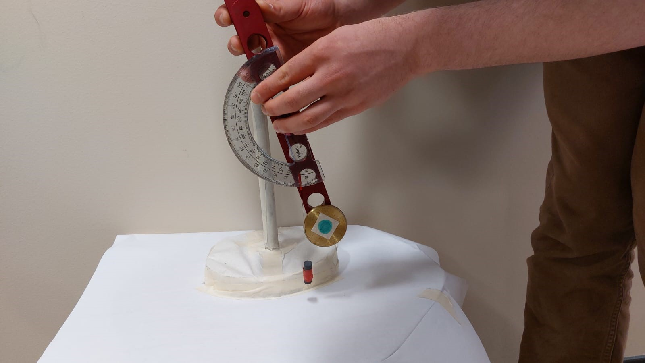
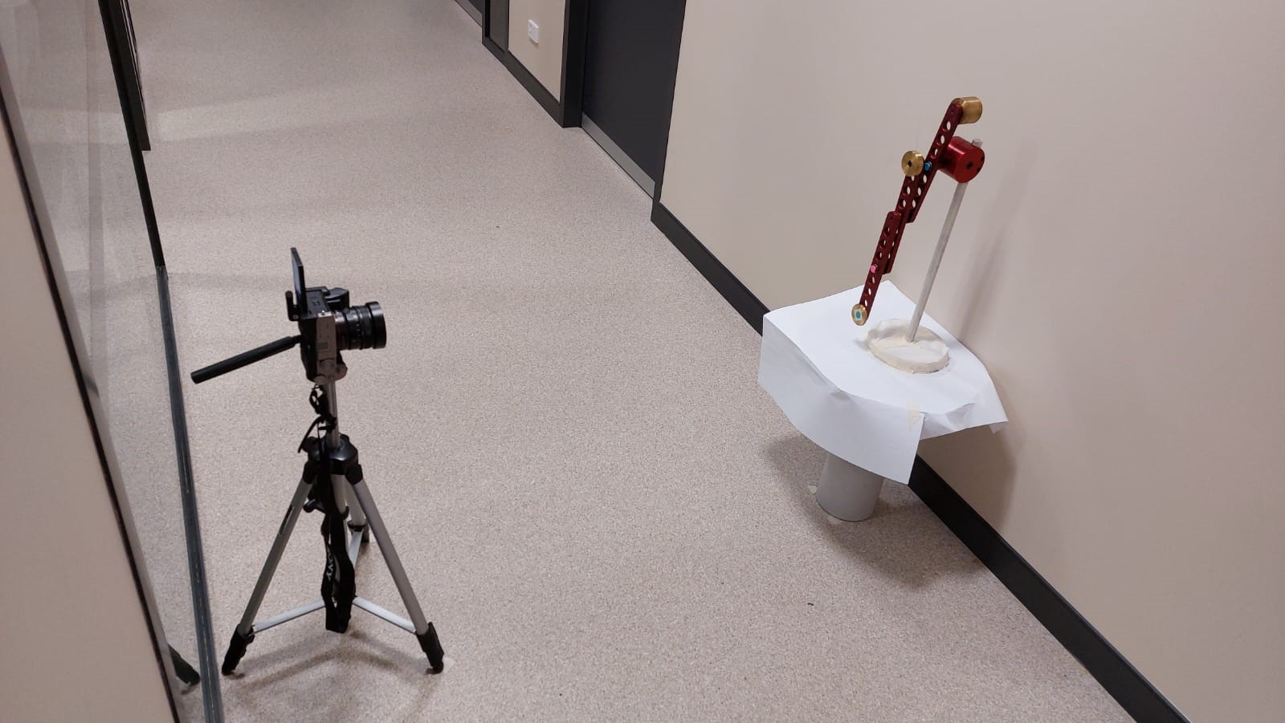
Methods – Data Acquisition
The triple pendulum (School of Physics USYD) was manually held so that all three arms were parallel and positioned to various initial angles before release.
Angles were determined by a makeshift device with a protractor and plum line
Video of the motion of the pendulum was recorded on a Sony A7C full-camera using a 24mm f2.8 lens at aperture f5.6.
1080x1920ppi resolution at 120FPS and 50MBPS bit rate.
Three replicate trials were recorded for each discrete angle and mass

Slide 6
Methods – Data analysis
MP4 video files
Motion tracking using Python
Trajectory path lengths were calculated using an OpenCV Tracker program in Python

Slide 7
Preliminary Results

Slide 8
Preliminary Results - 2

Slide 9
Discussion -

Slide 10
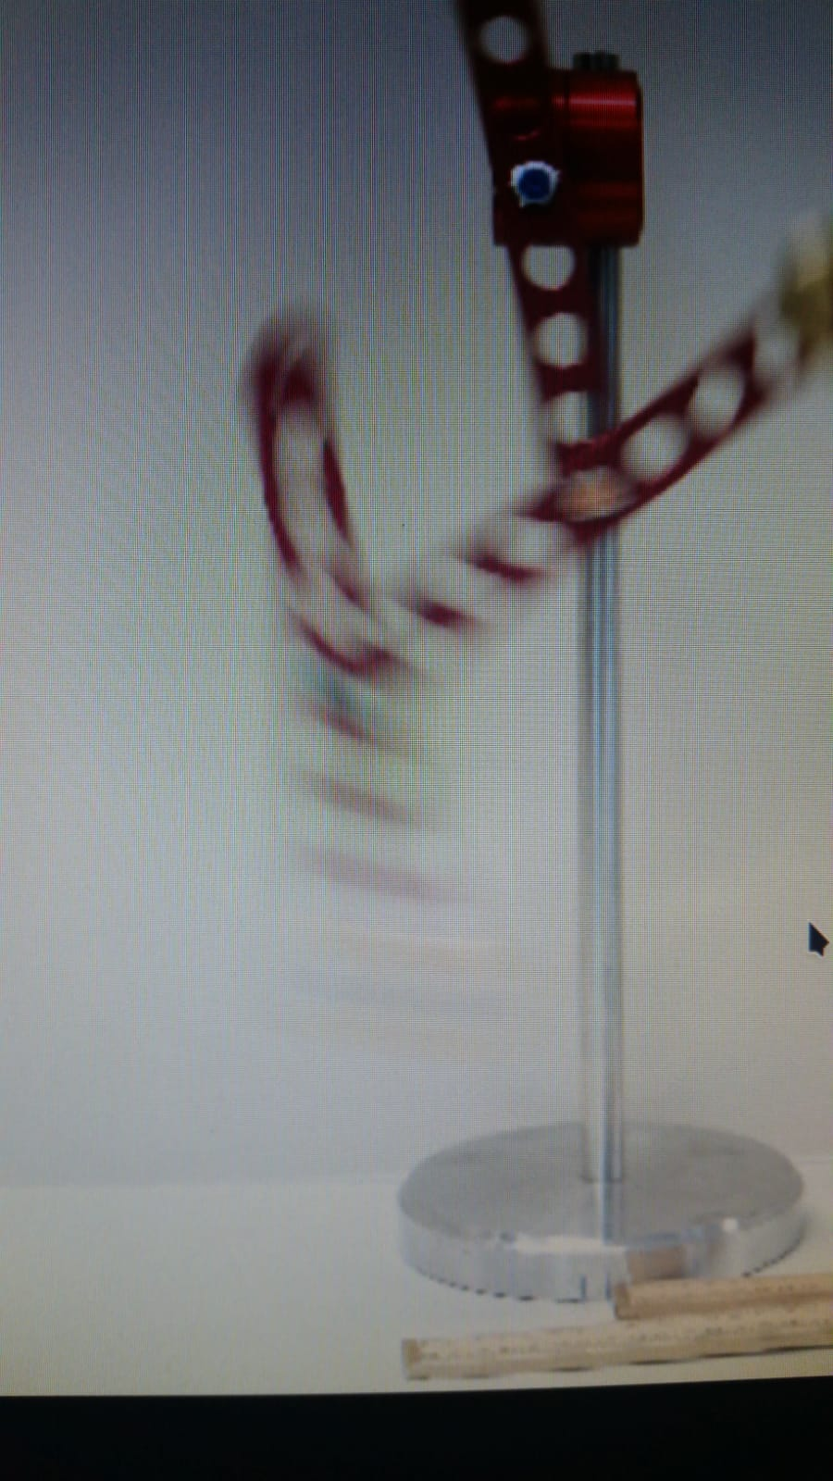
Discussion – Uncertainties & Difficulties
Initial condition angles were sighted manually and subject to parallax errors and human imprecision.
Initial video capture was at 24FPS, resulting in too much motion blur for the tracking software.

Slide 11
Conclusion

